Slide 1

BOOK RENTAL PROJECT
112103157-Shreya Yadav
112110079-Vaishnavi Mulik
Pit 1ch

Slide 2
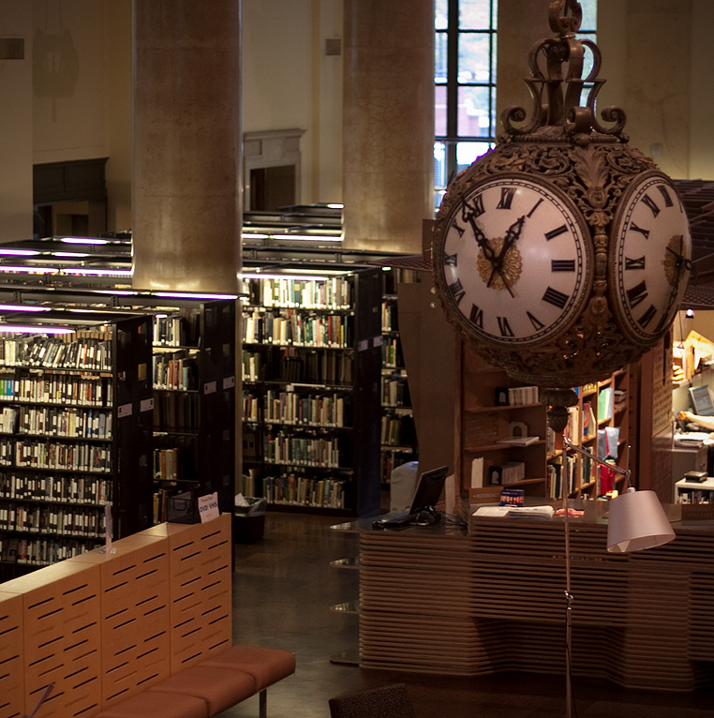
About Book store:
IT'S A FREE STORE!
We believe in providing books to everyone This is our initiative to make books available for all without letting them buy books This book rental store is free for all students of COEP
About

Slide 3
Goals and objectives:
MAKING BOOKS AVAIBLE FOR STUDETS:
Most of times, books from seniors are not passed on to juniors. We will make these books available for juniors through our store where students can rent a book for specified amount of time without any charge and pass on this book to juniors.
WE CALL IT A RENT! WITHOUT TAKING ANY CHARGE FROM STUDENTS WHY? :
we encourage the seniors to mark important points in book and keep book clean and tidy since it has to serve its purpose for longer duration of time

Slide 4
WORKING:
Options available at main interface:
1.Add Book Details- for adding the new book details into the store
2.Delete Book- in case we want to remove the book from store
3.Available Books- to see the list of available books
4.Issue Book- to issue a book to a particular student
5.Return Book- when a student comes to return book.

Slide 5
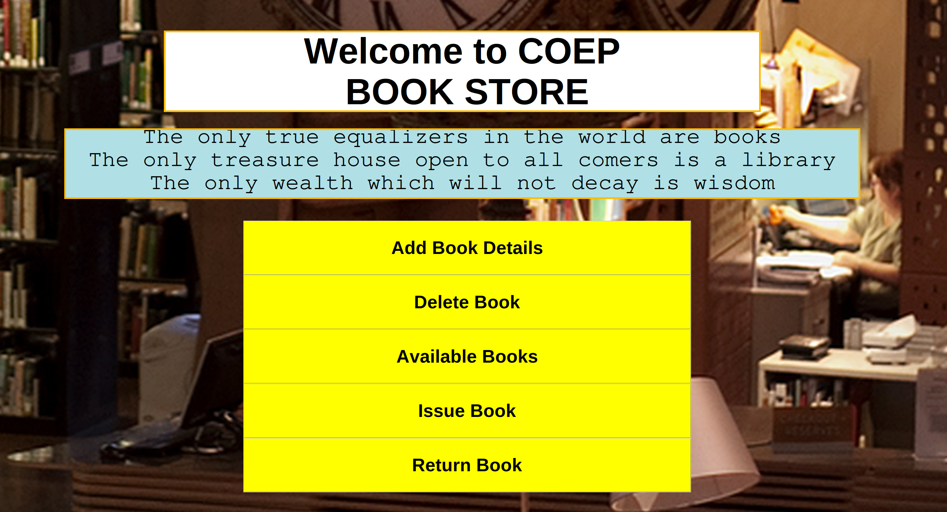
User Interface:

Slide 6
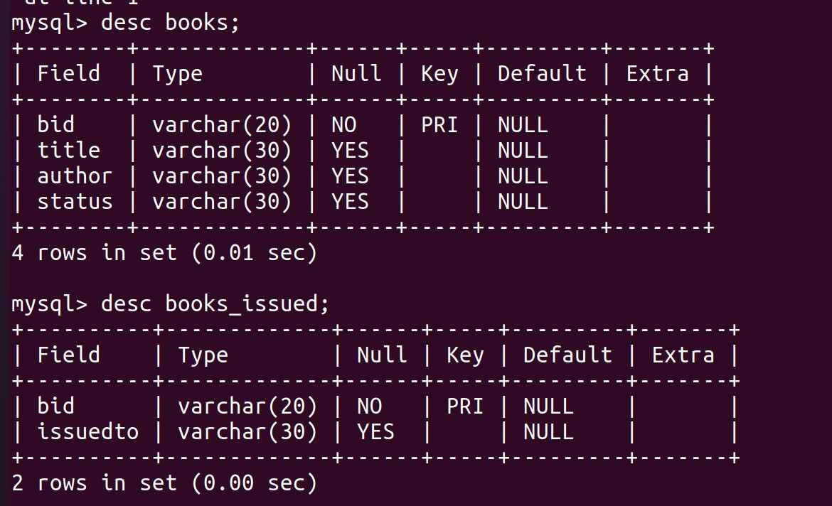
Database used:
MySQL:
MySQL is a popular and powerful open-source database management system that provides a reliable and efficient solution for storing, organizing, and retrieving data.
Created tables named books and book_issued

Slide 7
Python Tkinter:
For developing user interface of this virtual book store we have used tkinter.
Tkinter is a standard Python library used for creating graphical user interfaces (GUIs). It provides a set of tools and widgets to build windows, dialogs, buttons, menus, and other GUI components.

Slide 8
Thank you!!

